Slide 1
Countering the Media:
A solution to fear of Job Layoffs in the tech industry
Rahul Rajeev

Slide 2
CONTENTS
Introduction
Dashboard Review
Potential Solution
Visualizations
Conclusion

Slide 3
INTRODUCTION
The dashboard was created in order to combat the media regarding the exaggerated effects of the tech layoffs on the economy. I have found a potential solution and wish to present my results here.

Slide 4
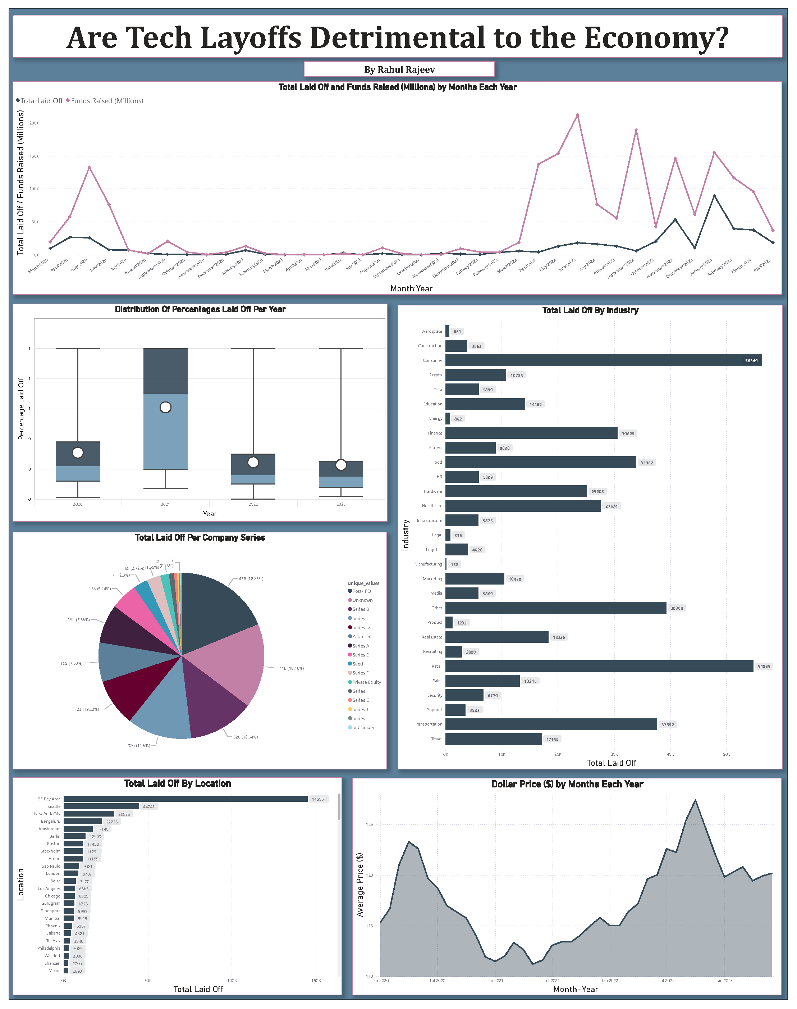
DASHBOARD REVIEW
Line Chart
  Large layoffs in 2020 in retail jobs, but tech jobs were hiring as they shifted to a digital workforce
  When companies reopened in 2022, profit was beginning to get better
  However, the dollar price was also dropping, so companies had to make the difficult decision to drop the extra workforce hired
Box Plot
  2021 had the highest distribution of people laid off (entire companies were closed)
Bar Chart – Industry Lay offs
  The consumer industry, followed by retail, were the top industries where people were laid off in the past 4 years
Pie Chart
  Each series of company had roughly the same percentage of people laid off so it’s not necessarily dependent on that
Bar Chart – Total laid off by location
  The bay area had the highest number of layoffs, followed by Seattle and New York City. The tech centers of the United States
* While the data presents interesting trends, it’s not exactly the easiest to read *

Slide 5
Potential Solution
A good solution would be to offer positions in the data science and machine learning department, especially involving AI as it is getting more popular and demanding. We can use data about data science positions to persuade people to apply.

Slide 6
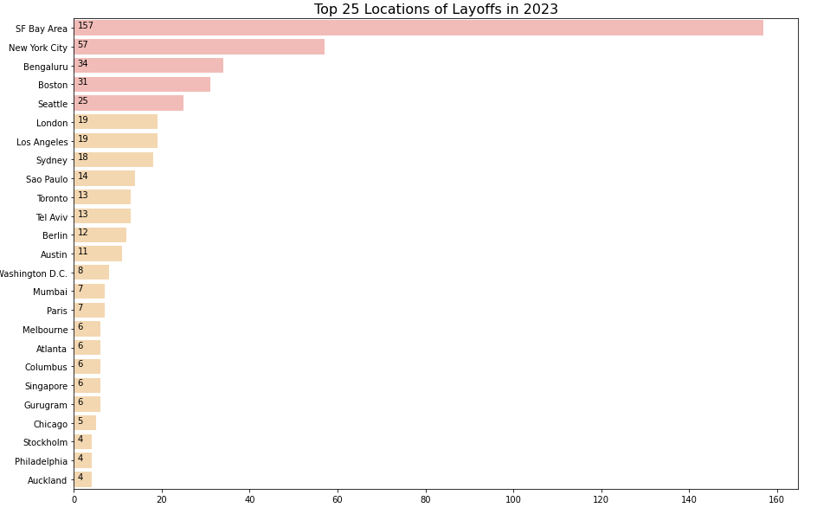
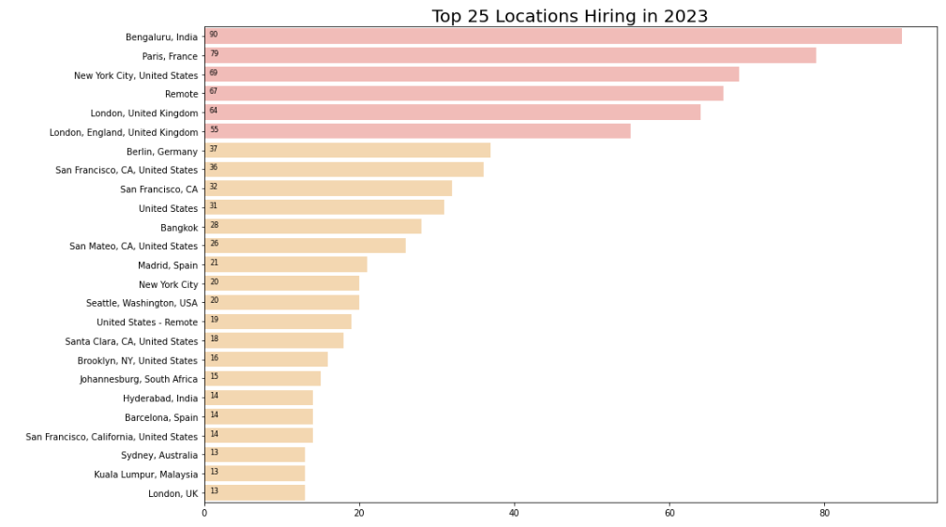
Layoff vs Hiring Locations
  The top 5 locations for layoffs in 2023 were the SF Bay Area, New York City, Bengaluru, Boston, and Seattle.
  The top 5 locations for hiring are Bengaluru, Paris, New York City, Remote, and London.
  * We can focus on locations that are frequent in hiring, even if it may be out of the applicant’s comfort zone. *

Slide 7
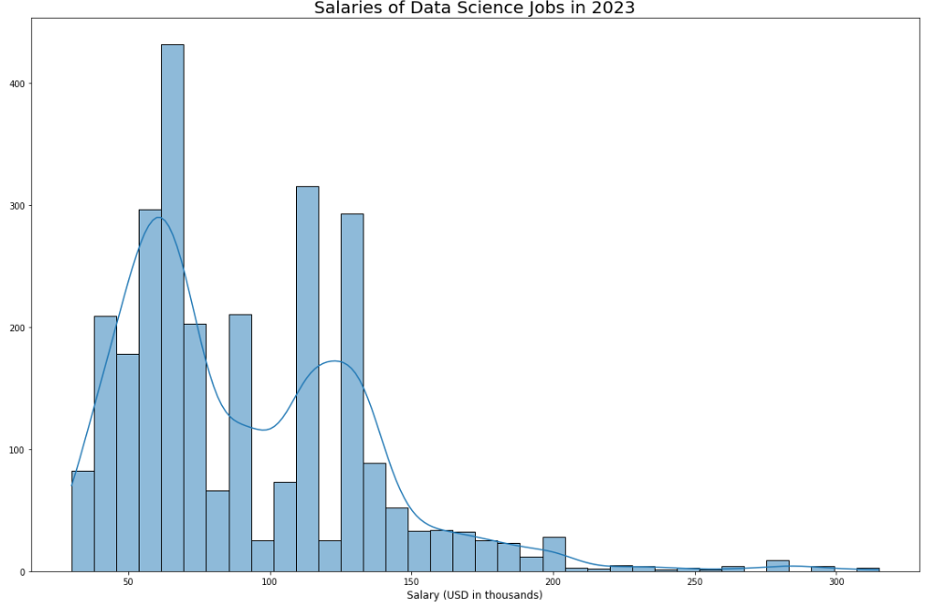
Salary Distribution
  The salary distribution peaks around $75,000 and peaks again at around $120,000. The distribution is skew right with few positions offering over $200,000 in salary. Positions in data science are quite high paying with high reward.
  * This visualization can demonstrate that data science positions are worth the extra effort put in to learn the different software. *

Slide 8
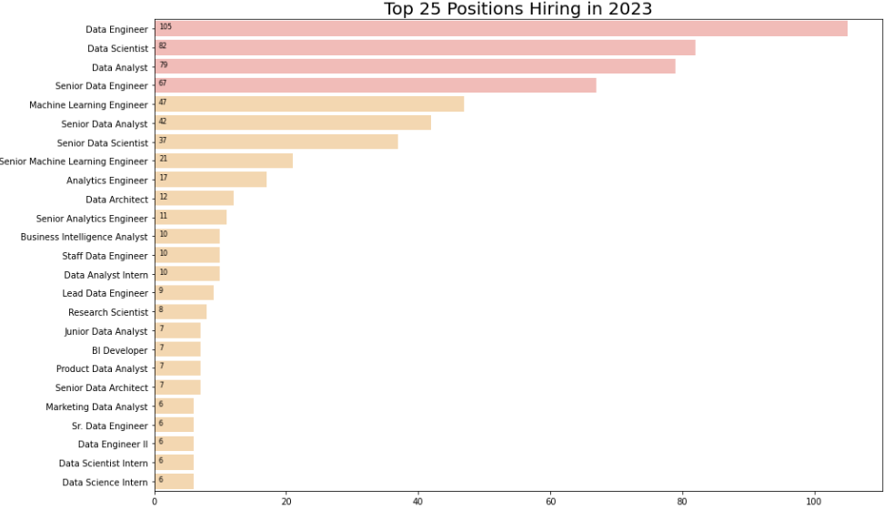
All Positions Offered
  The top 5 commonly offered positions are data engineer, data scientist, data analyst, and their respective senior positions
  The base level careers are entry/mid-level jobs, but senior levels jobs are still available
  Companies are gathering different kinds of data from complicated sources, so it makes sense that data engineers are one of the more highly sought out careers

Slide 9
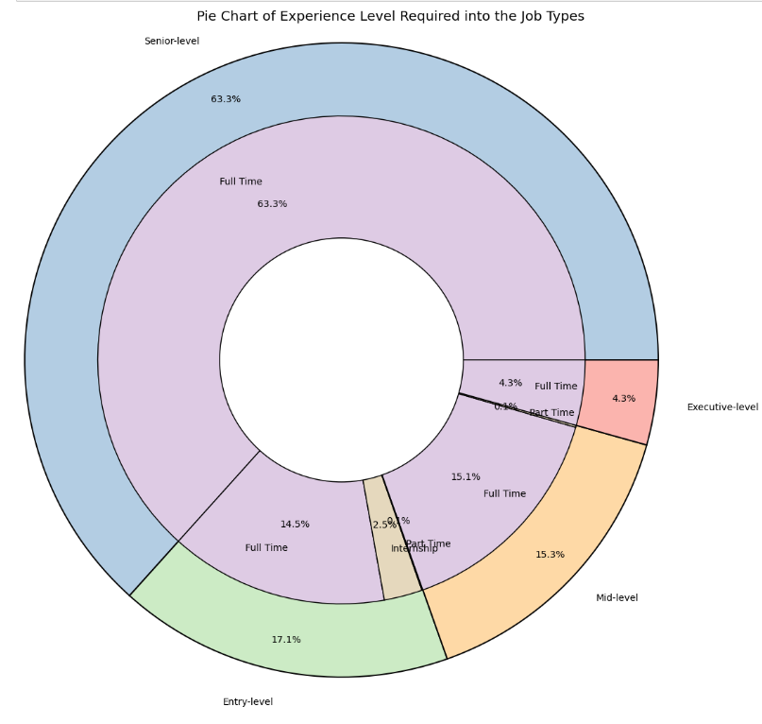
Job Level vs Job Type
  The chart visualizes how people of different seniority in the tech industry can afford full-time jobs in data science, once the right skills are acquired.
  Going from software engineering to data science may not seem like an easy jump, but those who have high understanding of coding can put their knowledge to work.
  With the addition of some data science techniques such as training machine learning models and learning to use visualization tools, it is a simple transfer.

Slide 10
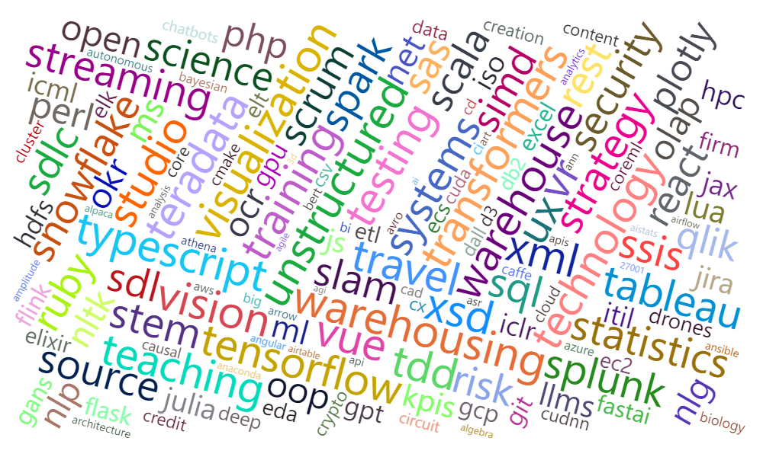
Skills to Pick up
  As a starting point for the additional techniques to be learned, this word cloud shows the most popular ones
  Visualization, training/testing, data warehousing, TensorFlow, Tableau
  This could also be a good addition to the infographic for convincing people to apply for data science positions

Slide 11
Future Business plan
Dashboard
Presentation
Blog Post
Infographic
Video
Summarizing Trends
Combatting the Media
Presenting a possible solution
Plan to convince the public
To share the results through news outlets and other visual sites
A physical representation of the solution and to convince the public
Used to present results in advertisement forms or any video media

Slide 12
Conclusion
By shifting our recruitment focus from software engineering to data science positions across a multitude of tech companies, we can both benefit the world of data science as well as our own business.
The availability of positions and the growth of the data science industry can effectively counter the media’s claims that one, layoffs are detrimental to the economy and two, that layoffs are the end of careers.

Slide 13
Thank you
Rahul Rajeev
Rajeev Recruiment LLC

